Slide 1
SECURE LAYER
Jay Patel
Metehan Ozsoy

Slide 2
Overview
Introduction
Project Platform and Tools
Our Solution
Challenges
Future Work

Slide 3
Introduction
Problem: Storing files and sharing them securely on cloud storage
Adversary: Cloud Server, Our Server
Google Drive does not provide the confidentiality

Slide 4
Project Platform and Technologies
Server : Tomcat 8
Client : Android Mobile
Language : Java
IDE : NetBeans, Android Studio
SSL : COMODO Certificate, OpenSSL, JSSE
WebSocket : WebSocketClient, ServerEndpoint

Slide 5
Our Solution
We develop an Android App that acts as a security layer between the user and Google Drive
Goal: Secure Server and Android App
Sign Up & Log-in
Uploading
Downloading
Sharing

Slide 6
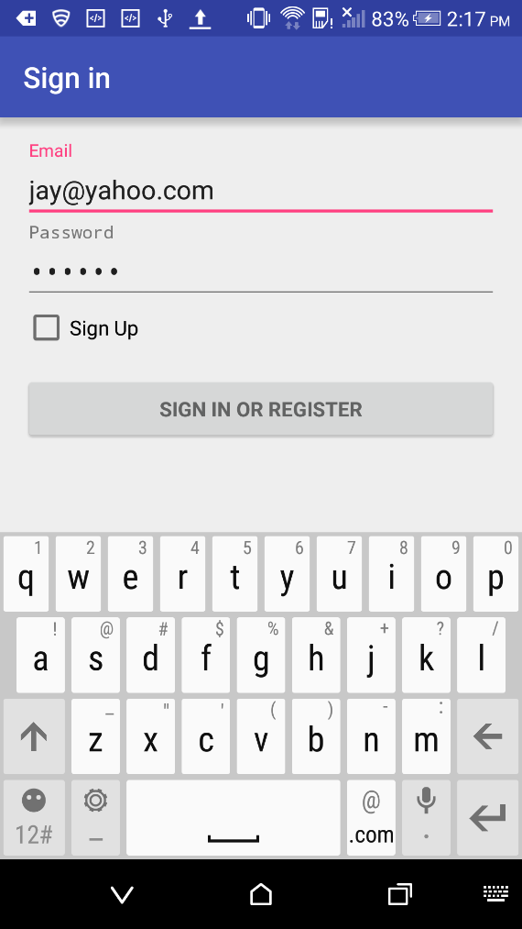
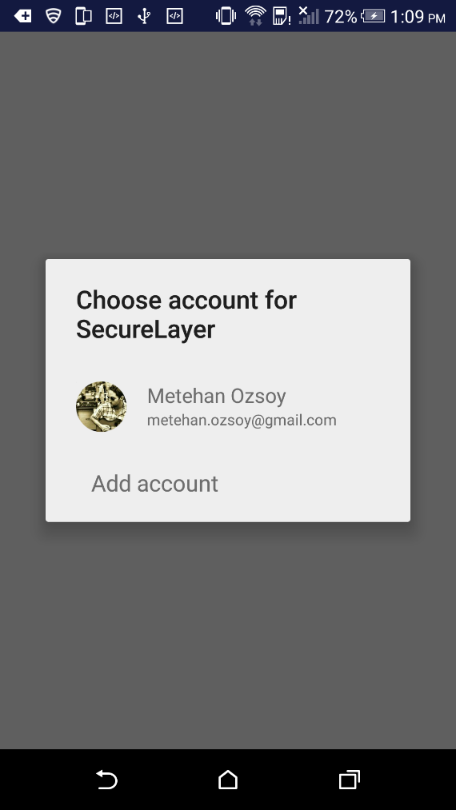
Sign up – Log in
Secure Layer Sign up – Log in
Google Drive Log in

Slide 7
Sign Up
User name: email address
Password
Hash(password) ➔ Server
Password is hashed using SHA-256.
Server checks if email id does not collide with an existing user.
On successful sign up, automatically login the user.

Slide 8
Log In
User can make only 3 login attempts, after that connection is dropped by the server.
Simple web socket connection is made using WebSocketClient API.
A successful log in process follows:
Send id and hash(pass)
Receive public key, g^{b} mod P, g, P (g is a primitive root modulo P).
Sends gª mod P encrypted using public key.
If the secret value ‘a’ < P, a = a mod (P-1).
A session key is established using DH key exchange protocol.

Slide 9
Upload
Establish Google Drive Connection
Encode the file
File Extension Length (4 bytes)
File Extension (10 bytes)
Store DriveID of the uploaded file

Slide 10
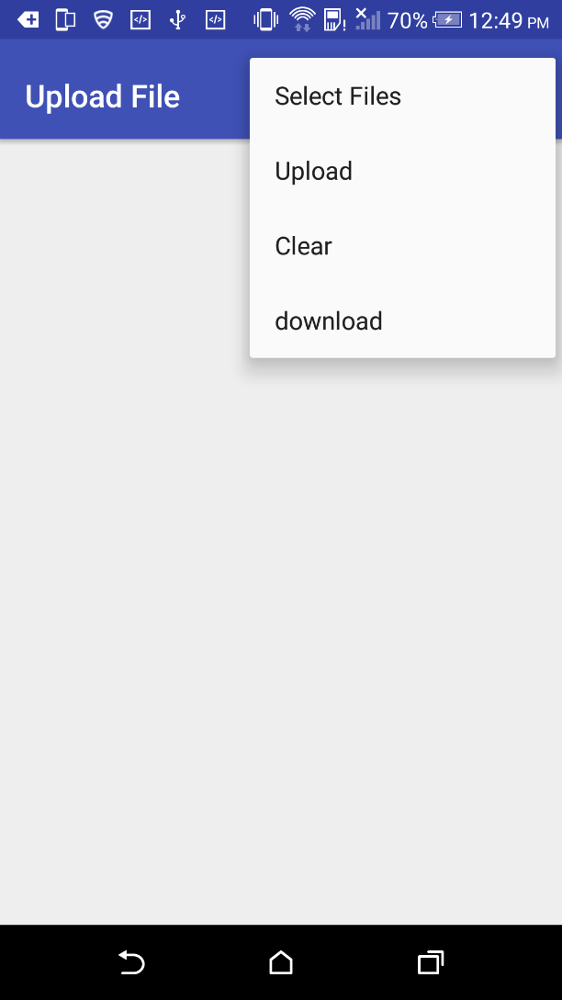
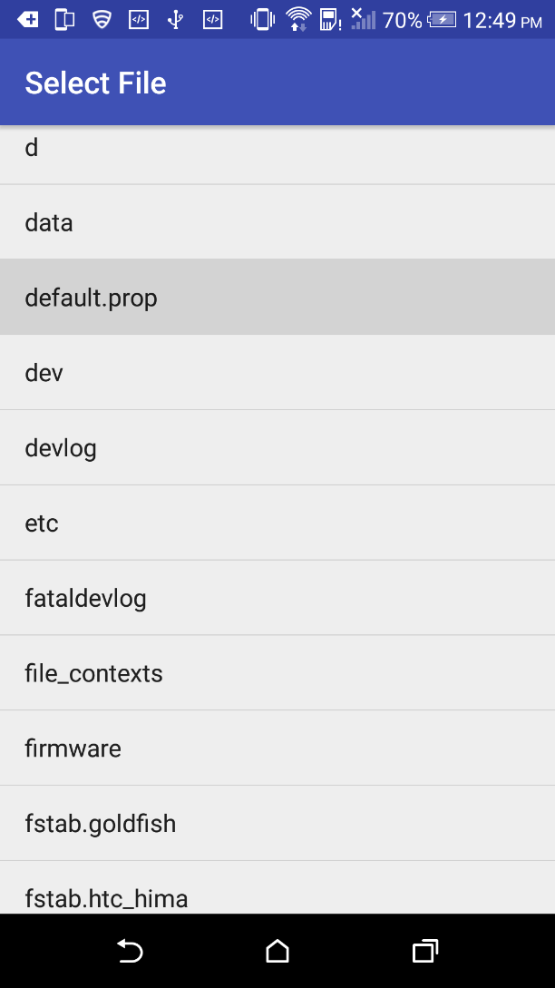
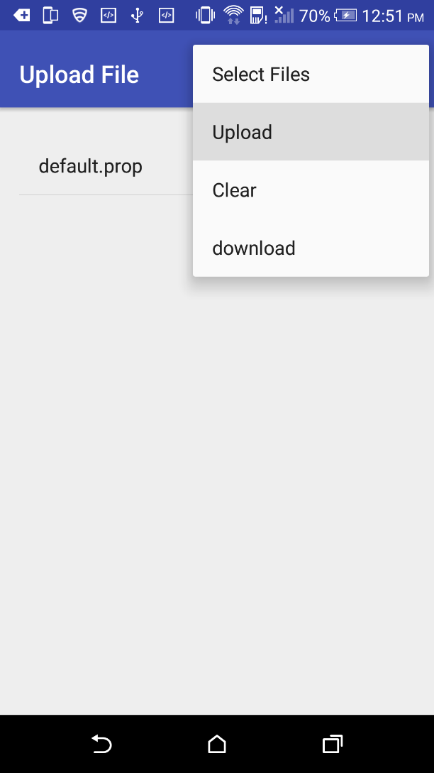
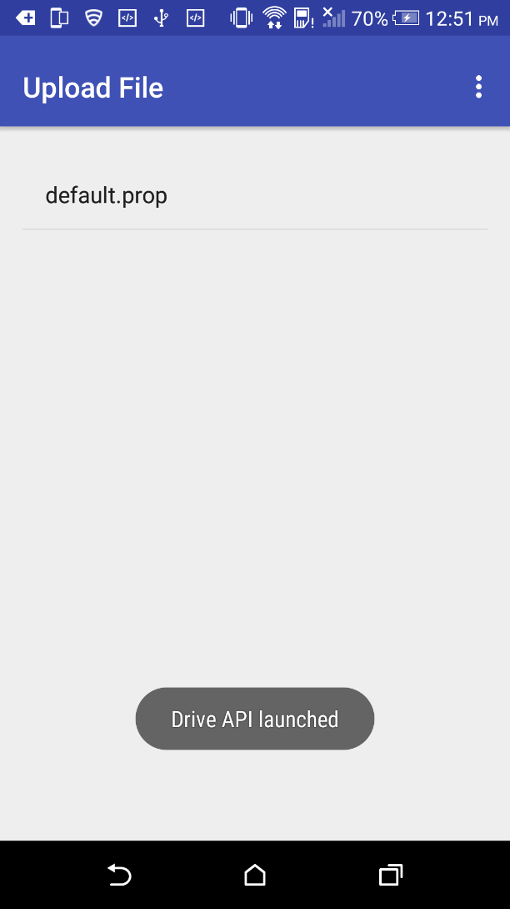
Upload

Slide 11
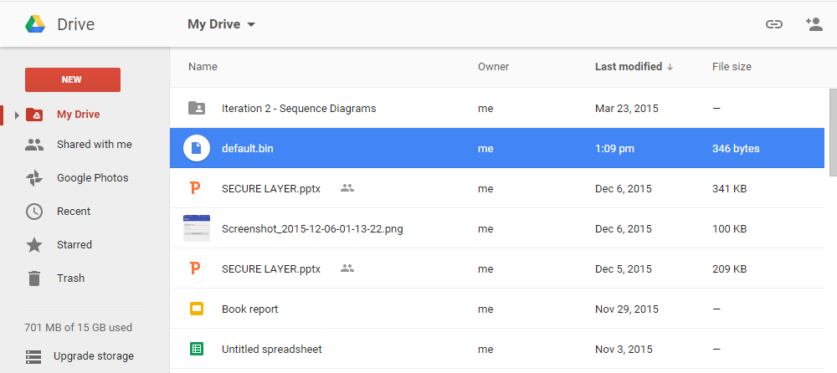
Upload

Slide 12
Download
Each file on Drive is associated to its unique DriveID
Establish Google Drive Connection
Download file using its DriveID
Decode file
Save file on mobile device

Slide 13
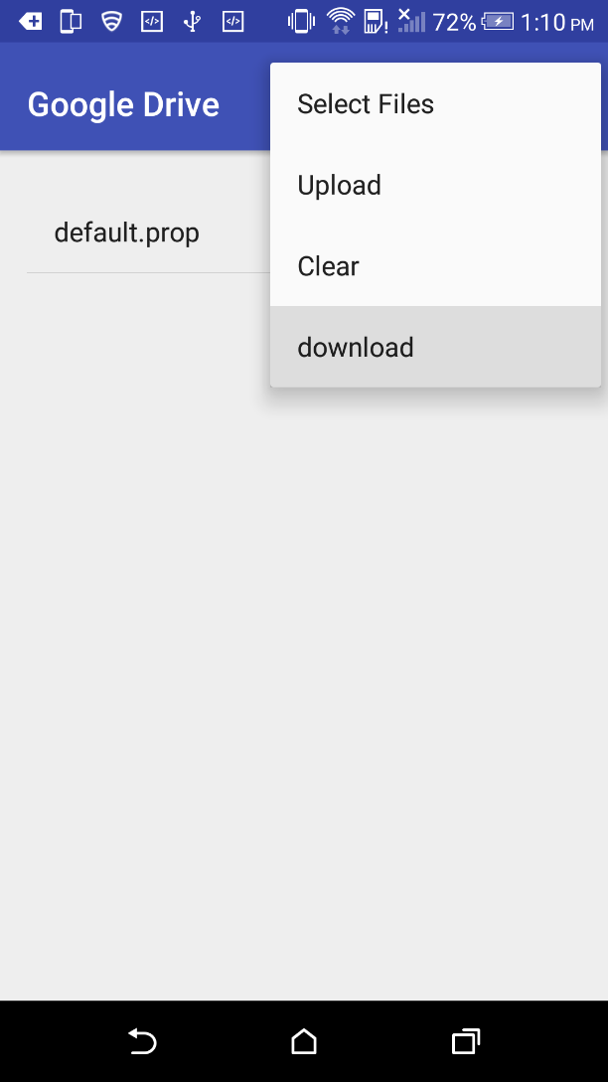
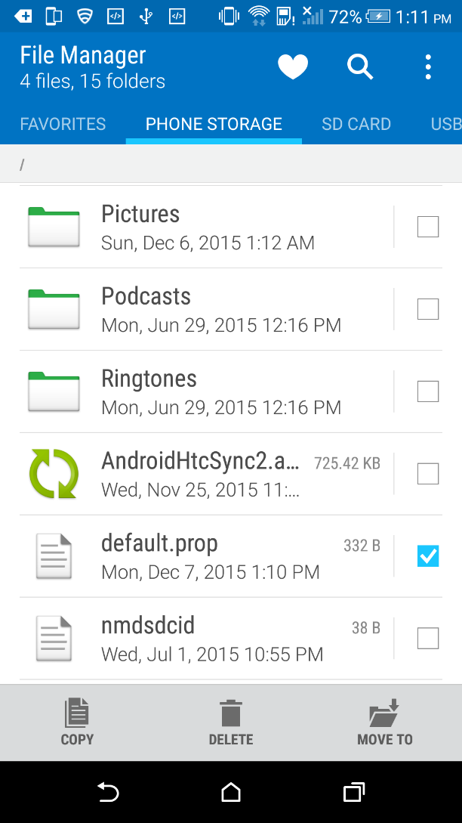
Download

Slide 14
Server Side
ServerEndpoint API by JSSE.
MySQL server using JDBC API.
Tomcat connects to the database as soon as it is deployed.
The manager functionality of server is secured using login credential.
Added JCE (Java Cryptography Extension) to unlock higher level cipher suites.

Slide 15
Server Side
COMODO Positive SSL certificate.
Web domain to link the certificate.
OpenSSL 1.0.2d.
Tomcat APR (Apache Portable Runtime) for OpenSSL.
RSA key pair (4096 bits).
Redirected common error codes (400, 403, 500) to static page.
Changed server shutdown port.

Slide 16
Challenges
SSL Certificate
Secure WebSocket Connection
Open SSL Integration with Tomcat Server
Drive API Implementation
File Extensions in Upload & Download
JSON Parsing Issues

Slide 17

Future Work
Implement Sharing
Sharing the file keys among users
Sharing the DriveID of the files
Encrypt the file using a key unique to this file: $Enc_{k}\left(f\right)$
AES256 - SHA384

Slide 18
References
[1] Seny Kamara and Kristin Lauter. Cryptographic cloud storage. In Radu Sion, Reza Curtmola, Sven Dietrich, Aggelos Kiayias, JosepM. Miret, Kazue Sako, and Francesc Sebe, Financial Cryptography and Data Security, volume 6054 of Lecture Notes in Computer Science, pages 136-149. Springer Berlin Heidelberg, 2010
[2] Wenying Zeng, Yuelong Zhao, Kairi Ou, and Wei Song. 2009. Research on cloud storage architecture and key technologies. In Proceedings of the 2nd International Conference on Interaction Sciences: Information Technology, Culture and Human (ICIS '09). ACM, New York, NY, USA, 1044-1048.
[3] G. Ateniese, S. Kamara, and J. Katz. Proofs of storage from homomorphic identification protocols. In To appear in Advances in Cryptology - ASIACRYPT ’09, Lecture Notes in Computer Science. Springer, 2009

Slide 19
QUESTIONS ???

